Slide 1
MEET
meetings with purpose.
November 18th, 2015
CS 147 – Behavior Change
Liza, Theodora, Tommy & Derin
Hi-Fi Prototype Midway Check-In

Slide 2
PROBLEM
MEETINGS

Slide 3
PROBLEM
MEETINGS
OFTEN UPRODUCTIVE

Slide 4
PROBLEM
MEETINGS
OFTEN UNPRODUCTIVE
LACK PURPOSE

Slide 5
PROBLEM
MEETINGS
OFTEN UNPRODUCTIVE
LACK PURPOSE
EXCESS PEOPLE

Slide 6
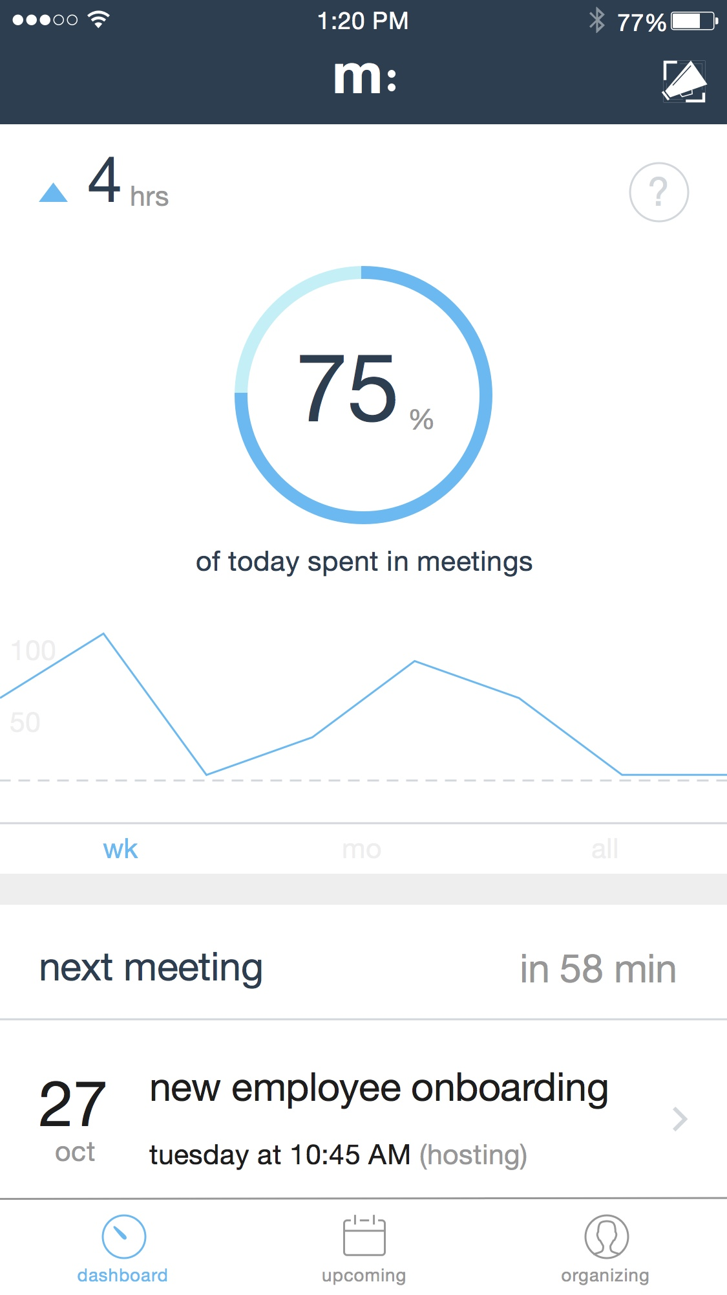
SOLUTION:
MEET
Talking points will help users schedule productive meetings with clear purpose.
RSVP allows users to inform the organizer of where they are relevant, and decline when they are not.
The meet dashboard helps users manage their meeting behavior and better understand how well their time is being allocated.

Slide 7

OVERVIEW
Heuristic Evaluation
Revised Design
Prototype

Slide 8
OVERVIEW
Heuristic Evaluation
Revised Design
Prototype

Slide 9
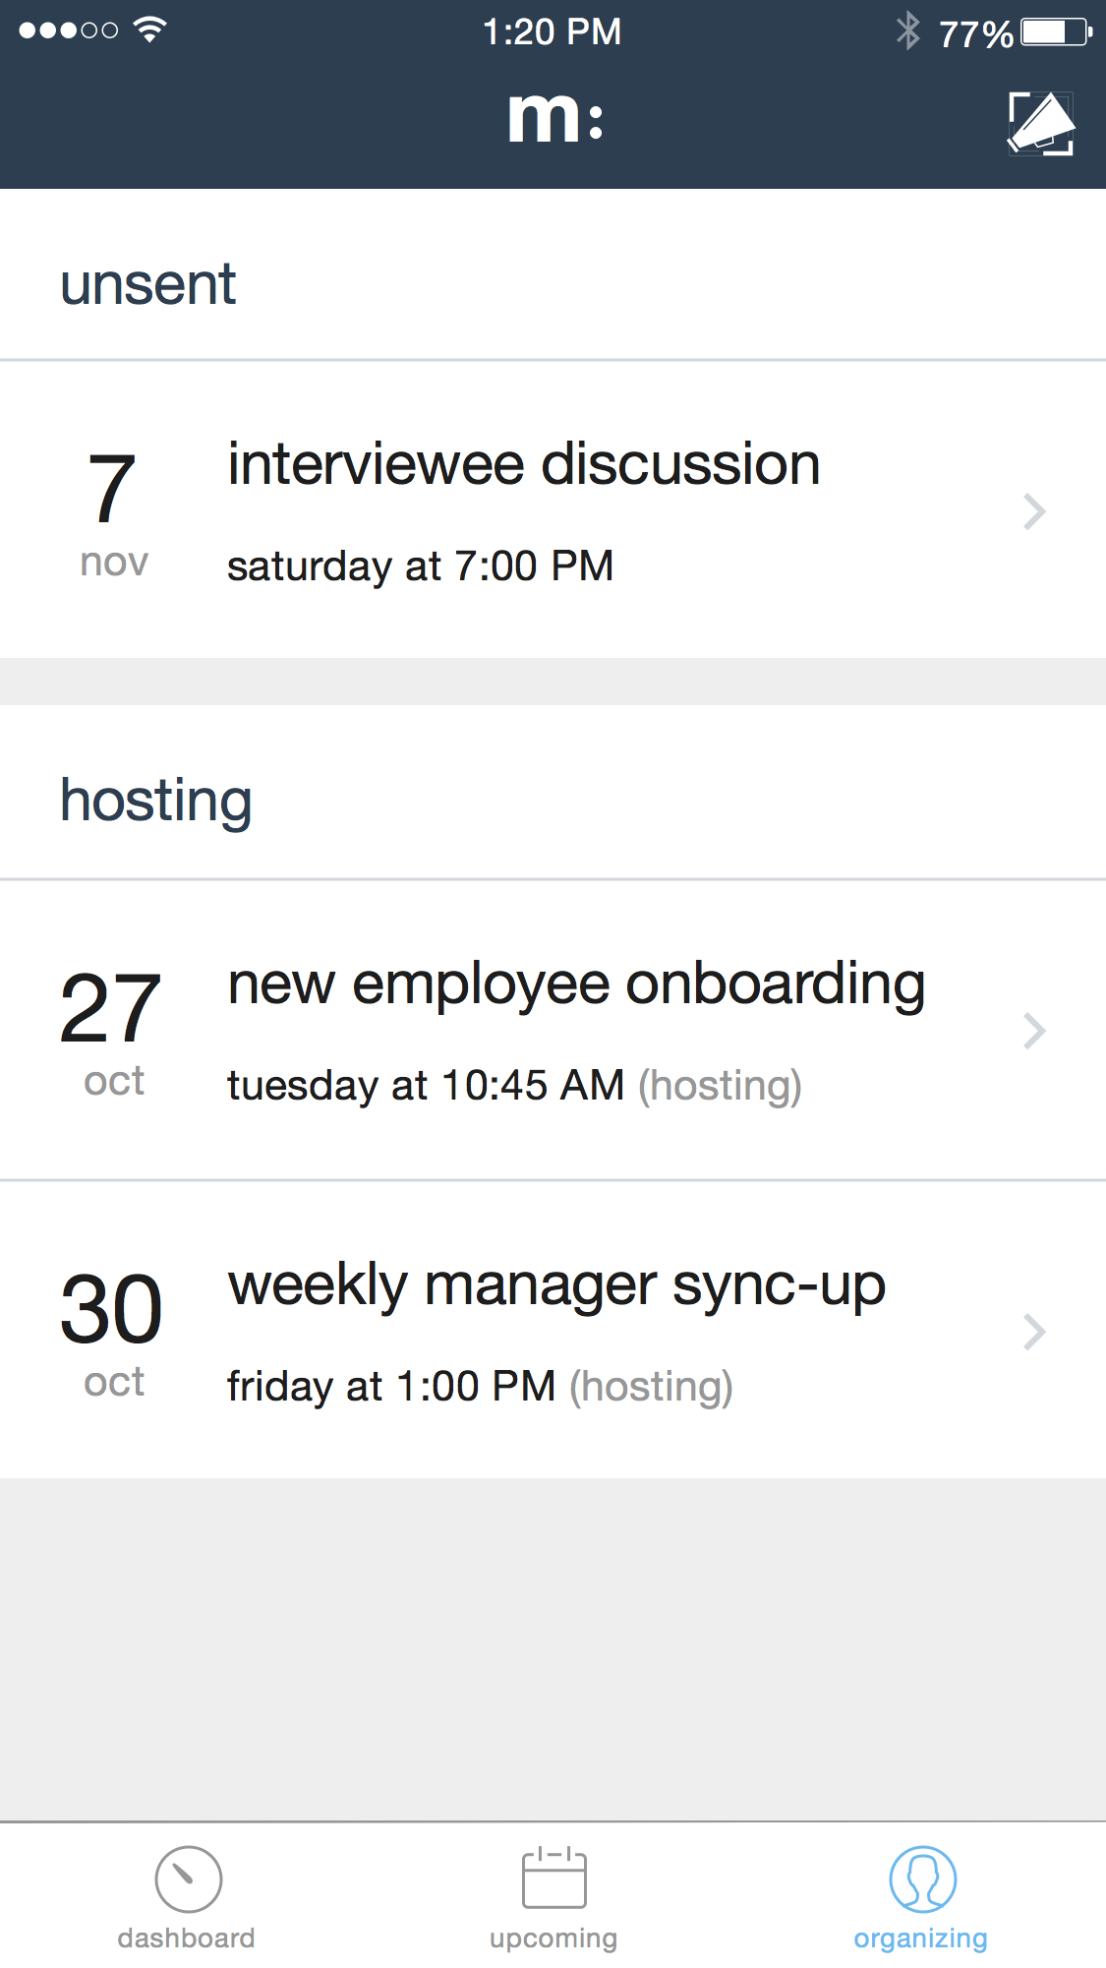
Heuristic Evaluation
[H2-9: User Control and Freedom] [Severity 4]
No option for creating another meeting without sending or canceling the current meeting.
If the user wanted to make multiple meetings before sending them to attendees, they would not be able to.
Implement a save function for meetings.
Our Solution: Added additional screen to access unfinished meeting invites and start new meetings

Slide 10
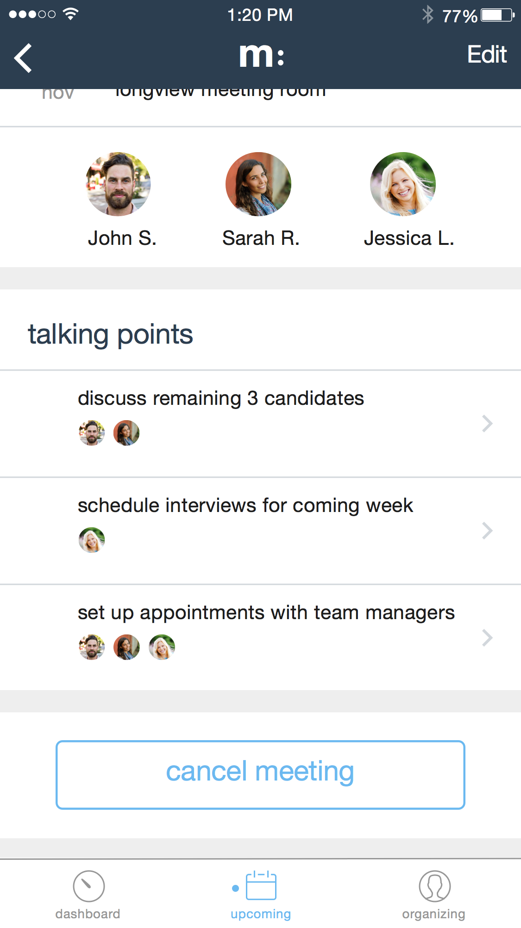
Heuristic Evaluation
[H2-9: User Control and Freedom] [Severity 4]
No way to edit/delete a meeting
Add an edit/delete button of the Meetings screen.
Our Solution: Added functionality to edit and delete meeting upon clicking of existing meeting that you are organizing.

Slide 11
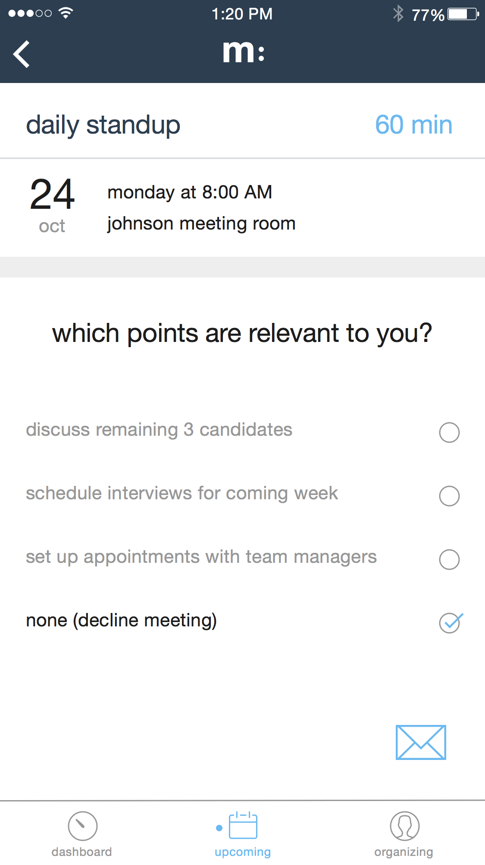
Heuristic Evaluation
[H2-9: User Control and Freedom] [Severity 4]
No way for user to easily decline an invite
Highly necessary given purpose of application
Add a ‘decline invitation’ button.
Our Solution: Declining option was to say ‘none’ on talking points. Updated copy of this option to make it clearer.

Slide 12
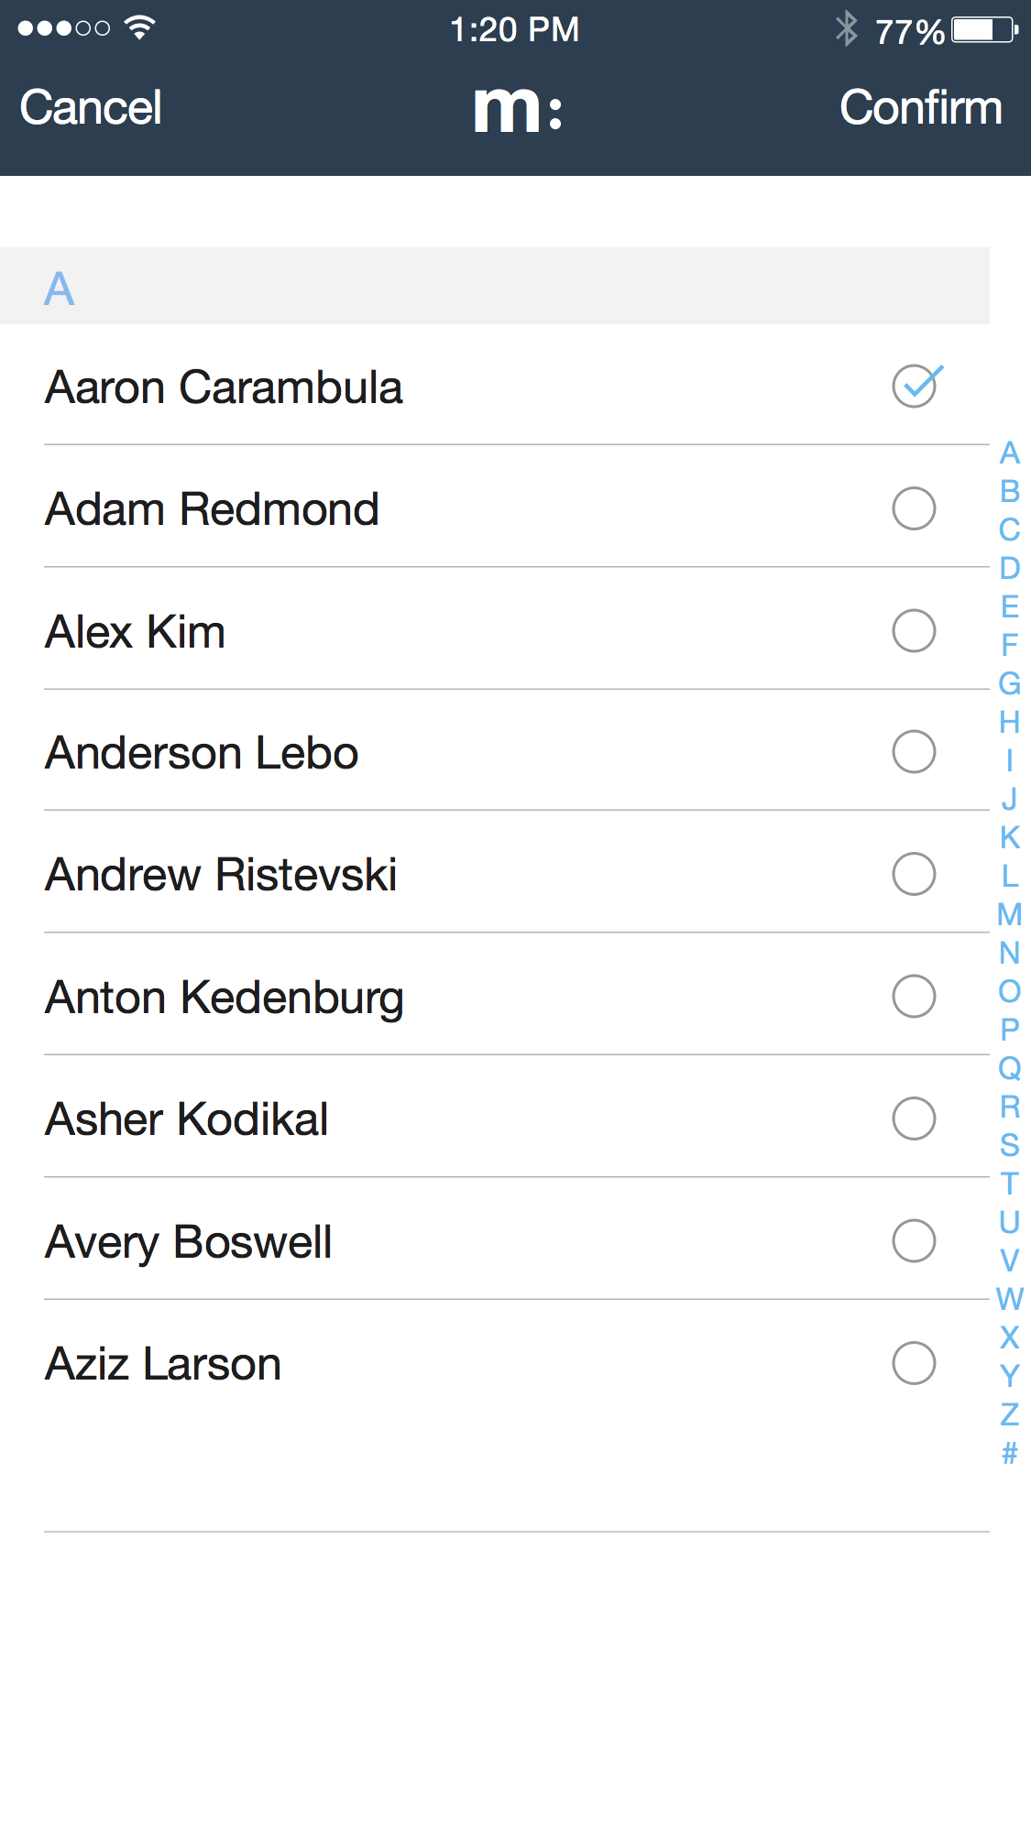
Heuristic Evaluation
[H2-7: Flexibility and Efficiency of Use] [Severity 4]
No option for selecting multiple people, all people, or groups of people on contact screen
Organizer may want to skip selecting specific people and just select a group and have the members decide if they should be there or not
Add a select all or allow for creating contact groups (recent, frequent, mobile team).
Our Solution: Added option to select multiple contacts on single click.

Slide 13

Heuristic Evaluation
[H2-1: Visibility of System Status] [Severity 4]
Home screen does not make sense
Users will be interested in in checking an upcoming meeting first.
First screen should be a list of upcoming meetings.
Our Solution: Changed landing screen to show upcoming messages.

Slide 14
Heuristic Evaluation
[H2-6: Recognition Rather than Recall] [Severity 4]
Add meeting time to all meeting related screens
Change titles of stats to make them more understandable
[H2-3: User Control and Freedom] [Severity 4]
Cancel out of create new meeting screen
[H2-9: Help Users with Errors] [Severity 4]
Implement error messages in Hi-Fi prototype
[H2-10: Help and Documentation] [Severity 5]
Add tutorials when user on boards
Provide other help and documentation

Slide 15
OVERVIEW
Heuristic Evaluation
Revised Design
Prototype

Slide 16
Revised Design
PRODUCT DESIGN // VALUE PROPOSITION
HOW DOES OUR USER EXPERIENCE COMMUNICATE OUR PRODUCT’S GOALS?

Slide 17
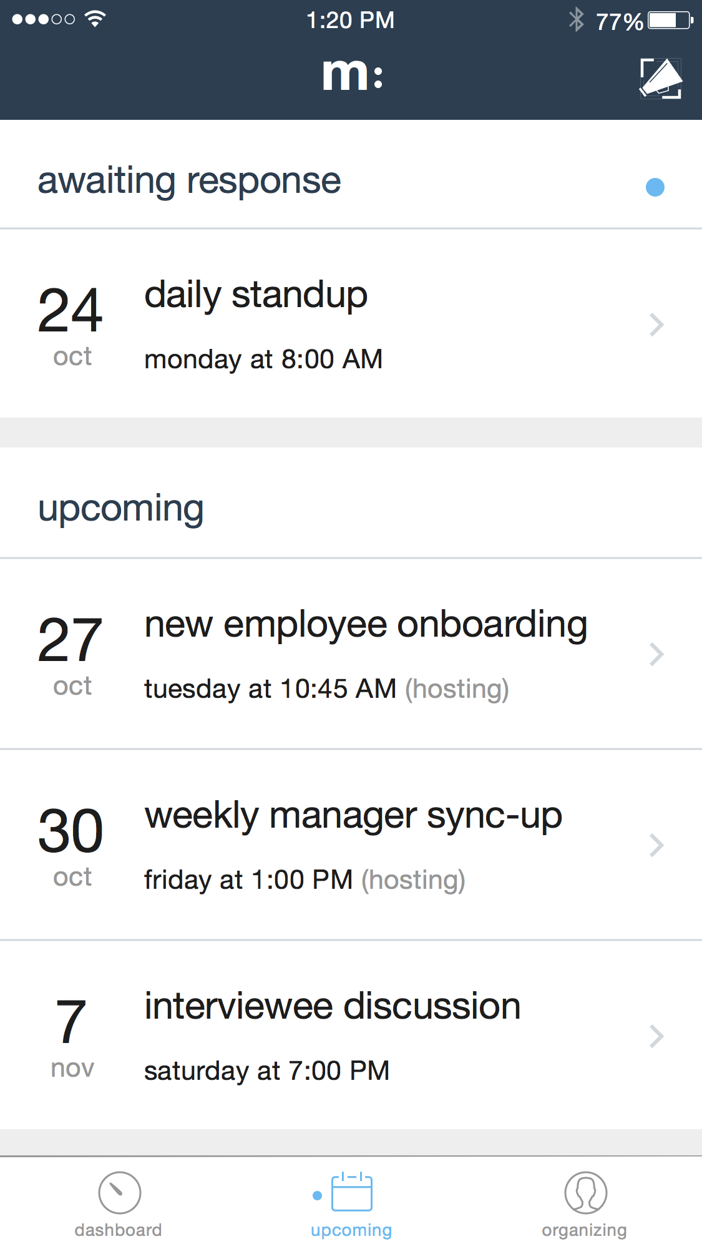
Revised Design

Slide 18
OVERVIEW
Heuristic Evaluation
Revised Design
Prototype

Slide 19
Prototype
DEVELOPMENT TOOLS

Slide 20
Prototype
IMPLEMENTED FEATURES
Meeting Organizer Flow
Backend for Users and Meetings

Slide 21
Prototype
UNIMPLEMENTED FEATURES
Home Screen & Dashboard
Upcoming Meetings Flow
RSVP
Login + Signup

Slide 22
Prototype
PROJECT COMPLETION PLAN
FINISH
DOCUMENTATION + ERROR MSG
NOTIFICATIONS
LOGIN
DASHBOARD
RSVP
UPCOMING MEETINGS
ORGANIZER FLOW
ADD USERS
Week 9
Thanksgiving
Week 10
Feb.

Slide 23
Prototype
WIZARD OF OZ / HARDCODE / QUESTIONS
Hopefully No Wizard of Oz Use
Notifications
Text Messaging
Will Add Users into the Database

Slide 24
PROTOTYPE DEMONSTRATION
Notes:
Talk about scheduling with who cares

Slide 25
THANK YOU!
Notes:
Talk about scheduling with who cares

